Slide 1
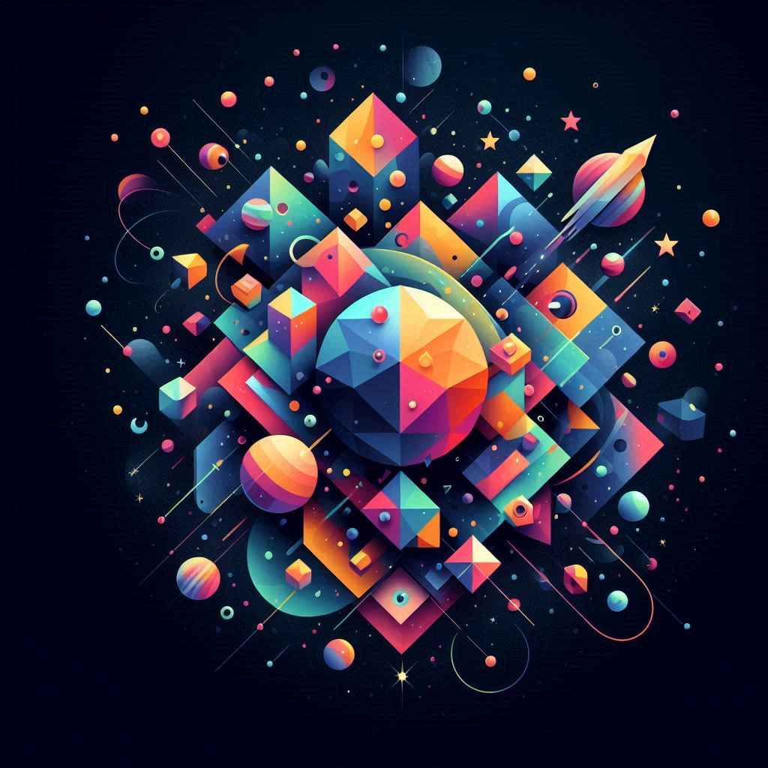

Intro & Motivation

Slide 2
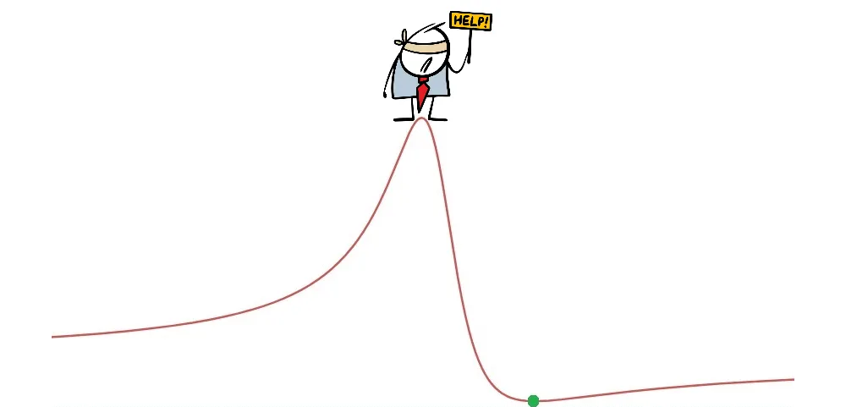
Why Gradient Based Optimization is Used

Slide 3

Auto-Diff from Scratch -
A Theory Behind

Slide 4
Auto-Diff from Scratch -
An Implementation

Slide 5
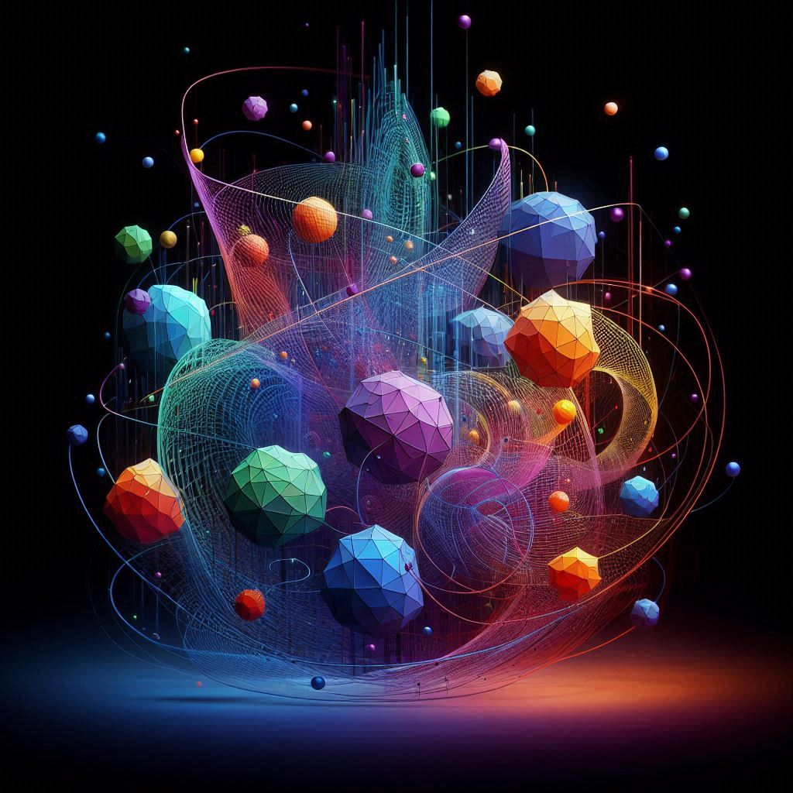
Auto-Diff from Scratch -
Tensor Support

Slide 6
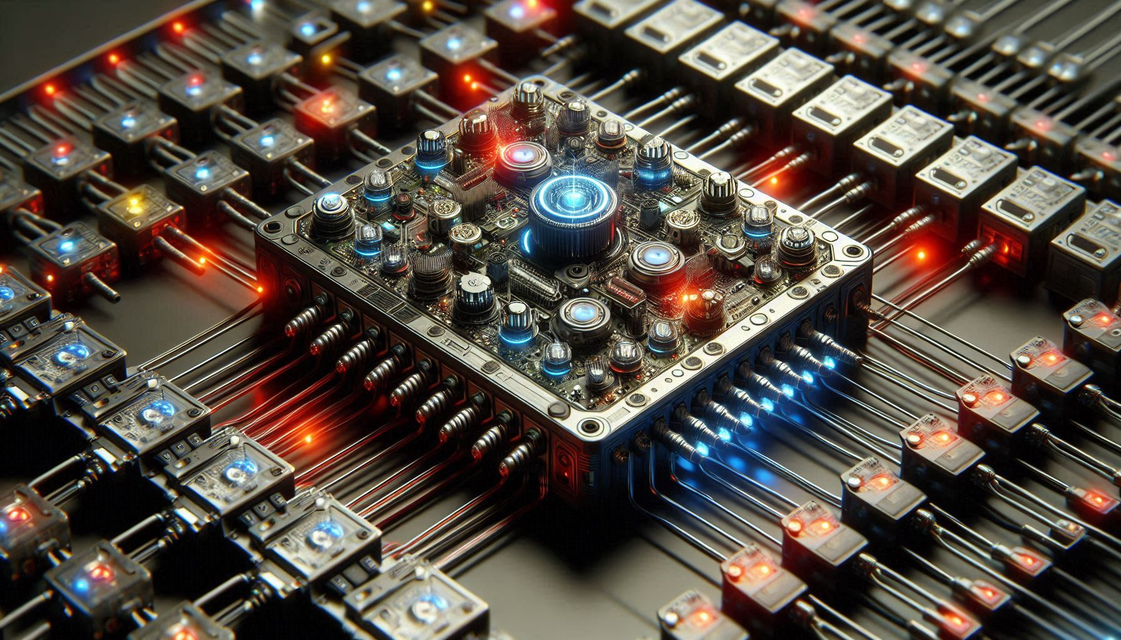
Module Class

Slide 7

Dataset and Data Loaders

Slide 8
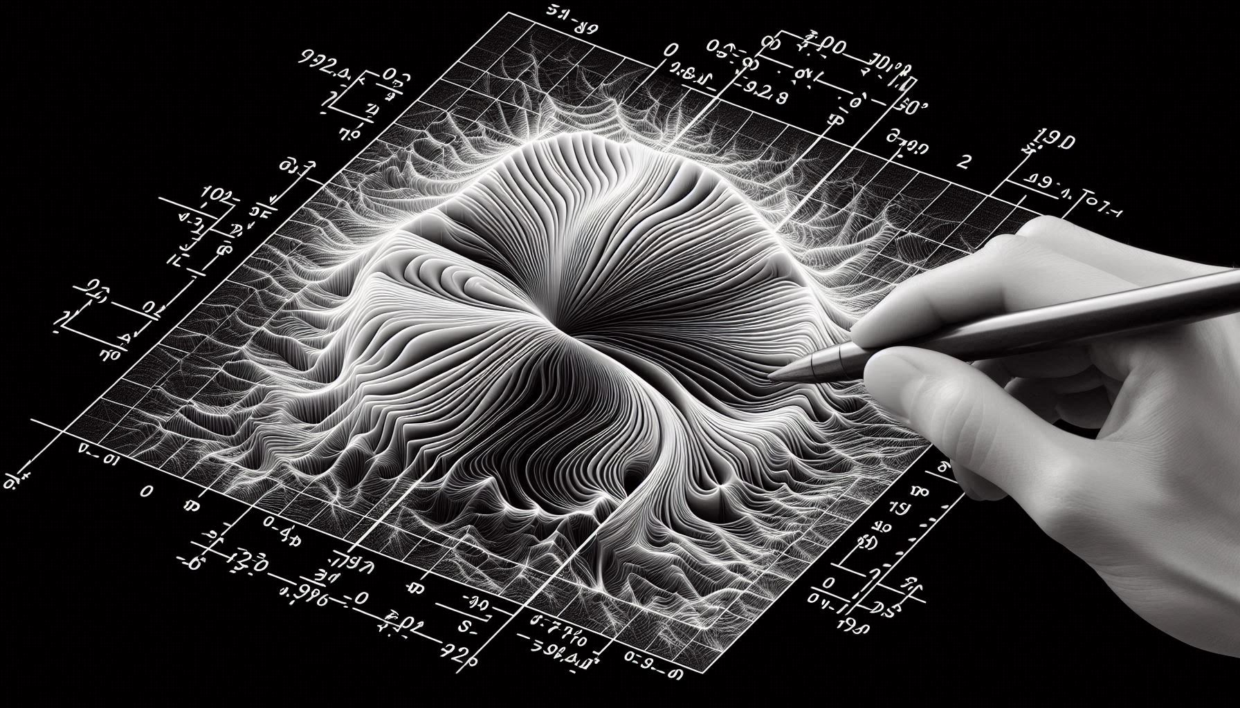
2D Convolution

Slide 9

2D Pooling

Slide 10

Batch Normalization

Slide 11

Dropout

Slide 12
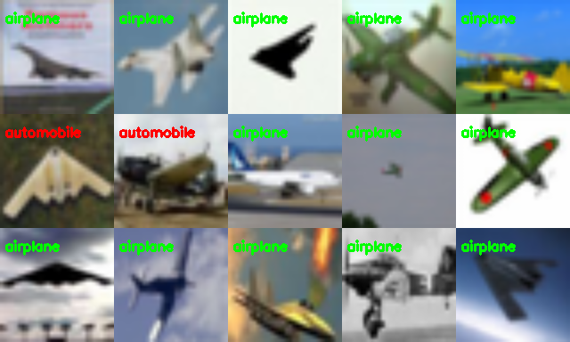
531692
Sample: classification – ResNet!

Slide 13
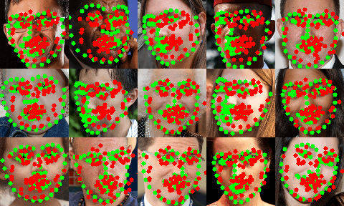
531692
Sample: Face Landmark Detection

Slide 14
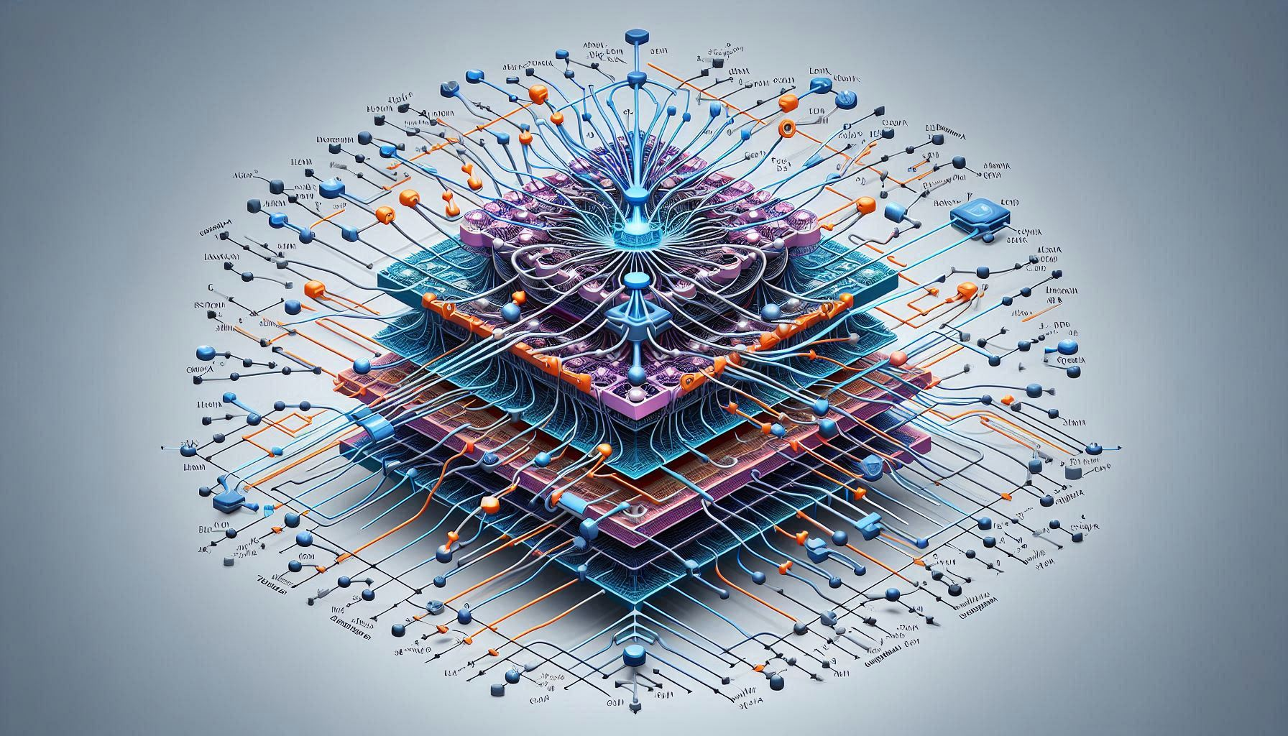
Transposed Convolution

Slide 15
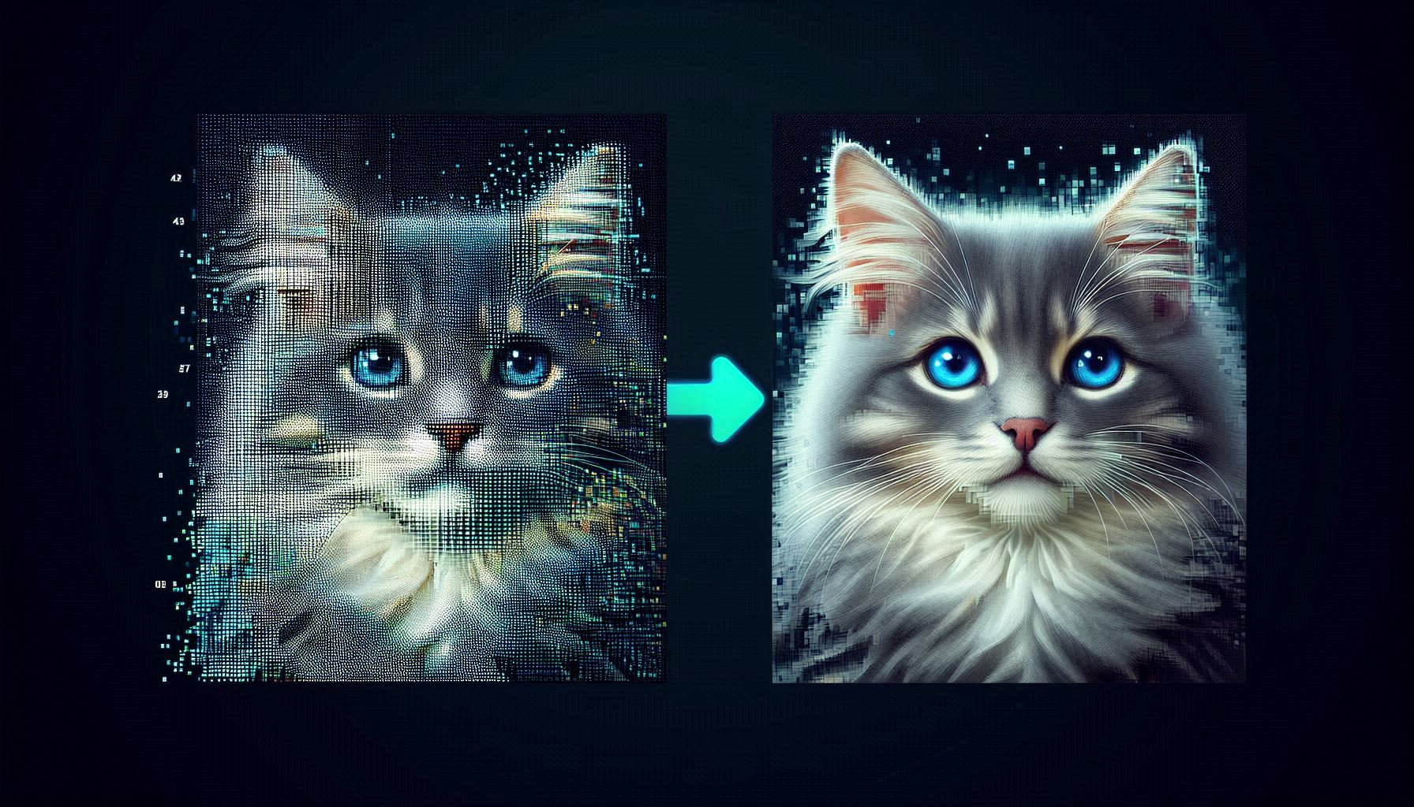
2D Upsampling

Slide 16
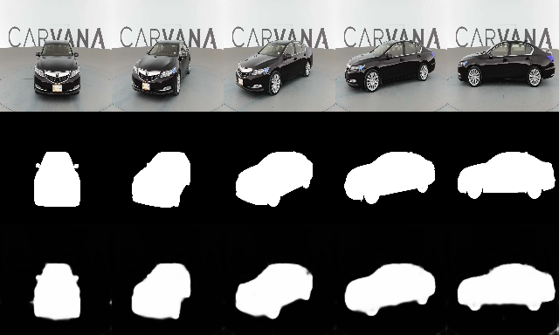
UNet - Segmentation Sample!

Slide 17
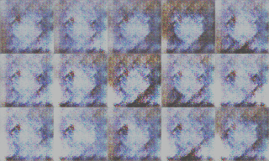
531692
Sample: Anime generation - DCGAN

Slide 18
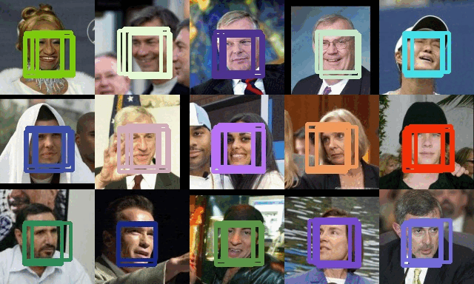
YOLO from Scratch!

